Slide 1
SGS Facebook Training
part 1
21 March 2020

Slide 2
OVERVIEW
WHAT IS COVERED IN THIS TRAINING
Before you start: knowledge and resources
SGS audience stats
Facebook main views/dashboards
Creating posts & events
Preparing content and planning ahead

Slide 3
QUICK FACEBOOK FACTS
39 Million Users in the UK
2.449 billion users globally
500,000 new users every day globally
60 million active business pages on Facebook

Slide 4
WHATs and WHYs
Reflect before you start – familiarize yourself with SGS history, mission and main activities:
https://scotlandsgardens.org/about-us/
Volunteer Resources on SGS website is where you will find templates and examples:
https://scotlandsgardens.org/resources/
WHO are you talking to?
Get to know your audience, find out their demographics, interests, location.
WHAT are you trying to say?
Be clear on what message you are trying to pass through, what is the main thing you want people to find out?
WHY does it matter?
Learn your organization’s mission, see a big picture.
Do they care?
Are people responding to your content? How does it relate to them? Remember – it is about them, their values and needs.

Slide 5
SGS FACEBOOK AUDIENCE, MARCH 2020
4,113 followers
3,719 page likes
People can follow your feed without having to ‘like’ your page.

Slide 6
AUDIENCE - DEMOGRAPHICS
Most of our fans are women between 35 – 64 yo

Slide 7
AUDIENCE - LOCATION
Edinburgh 430
Glasgow 243
Aberdeen 148
Dumfries 80
Inverness 72
UK (including Scotland) 2,744
USA 243

Slide 8
AUDIENCE - ACTIVITY
SGS followers are most active at 1pm
Saturday is the most popular day for our followers to be on Facebook
Most popular are posts with link, then images and finally - videos

Slide 9
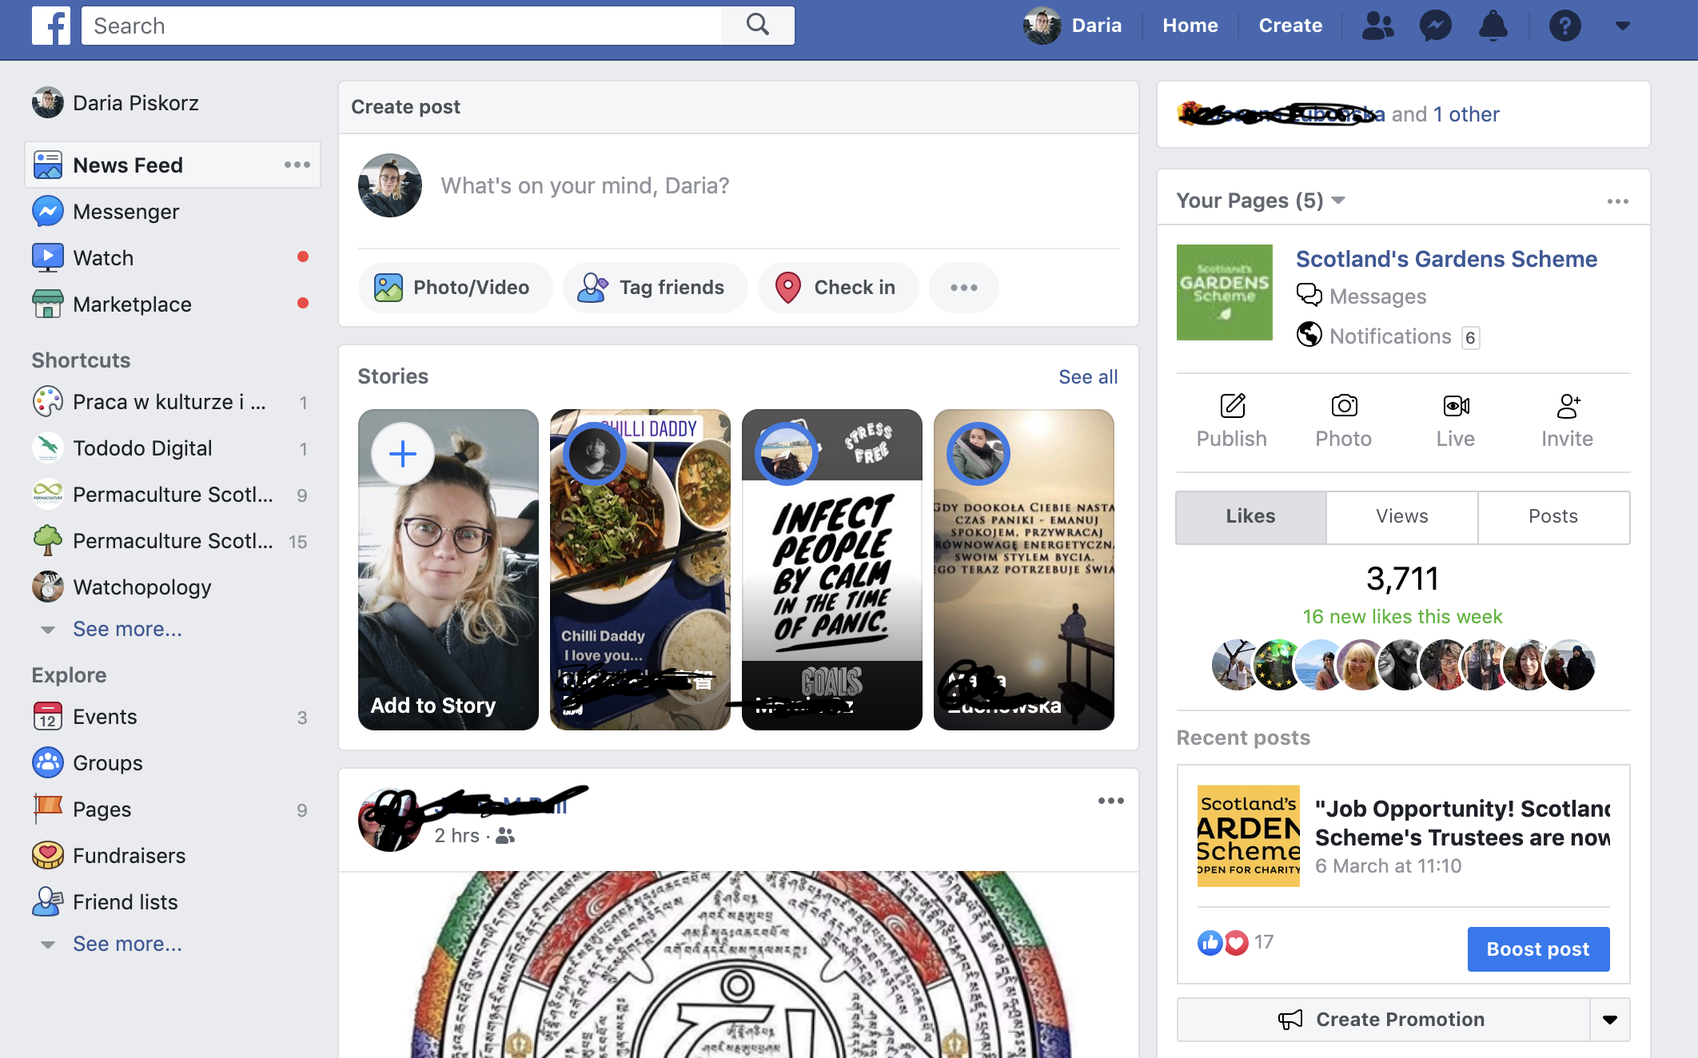
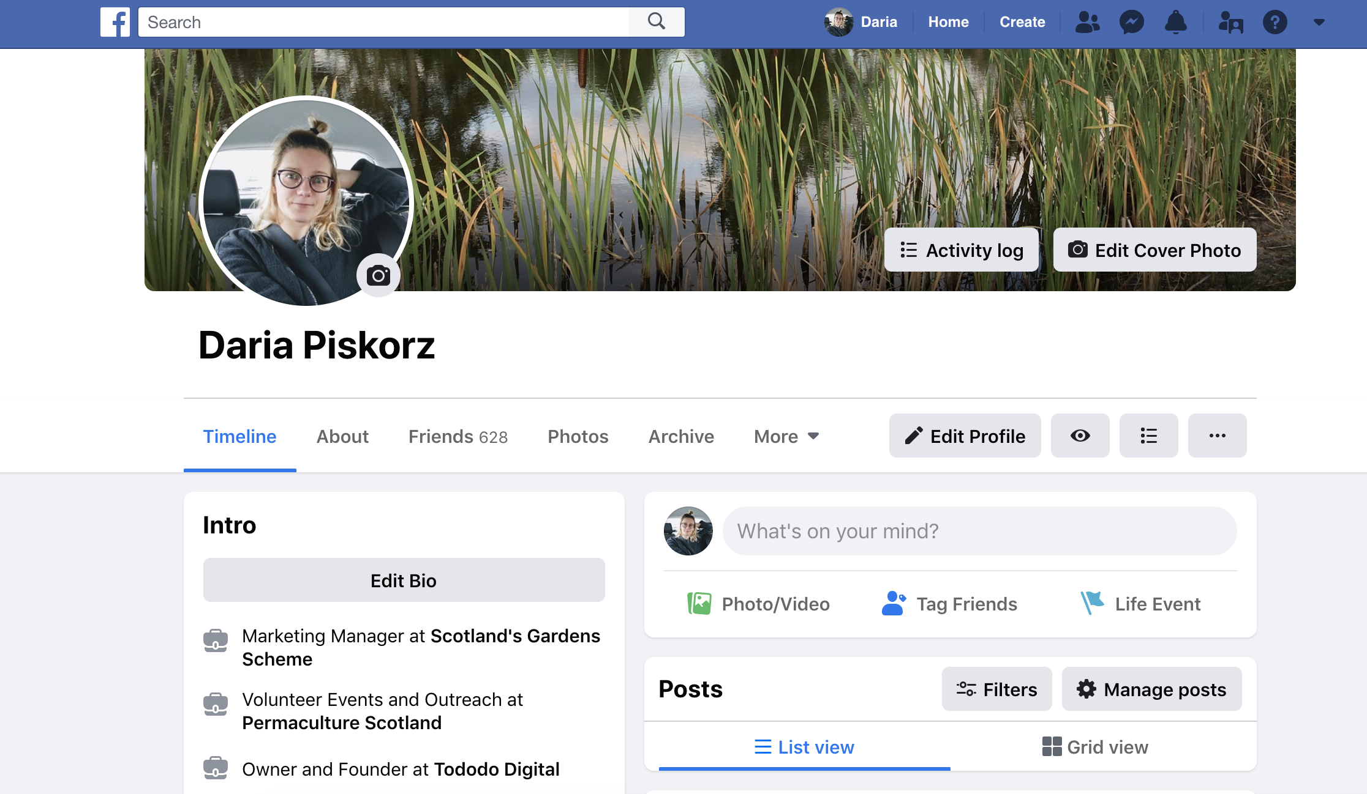
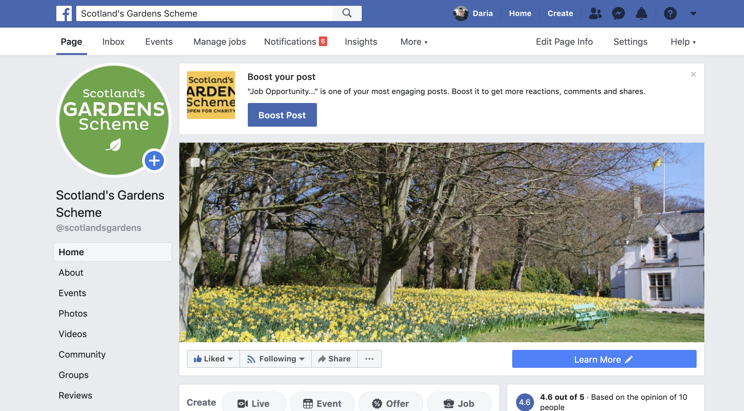
3 MAIN ‘DASHBOARDS’
This is view when on desktop.
Home Page (newsfeed) Your profile page Organisation Page

Slide 10
HOME PAGE – NEWS FEED
SGS page can be accessed from here. If you can’t see it, click on an arrow to expand.
Here you post as yourself (private person)
Here you can find all pages that you manage as an admin or editor
Your friends’ posts

Slide 11
YOUR PROFILE PAGE (as private person)
Click on HOME to come back to News Feed
Back to home page
Profile picture – click on the camera icon to change.
Here is where you can type something to share with your friends.

Slide 12
YOUR BUSINESS PAGE
To go back to your private profile, click on your pic
Fb will try to make you boost your posts (paid), ignore it.
SGS profile pics (we keep it always the same – your district logo)
The dimensions for a Facebook cover photo are 828 x 315 pixels (but only 560 x 315 px on mobile)
Username – only admin can add or change.
CTA (call to action)
encourages people to do certain things, eg message you or go to your website.
You can create your post here or in Publishing Tools – more about it later

Slide 13
YOUR BUSINESS PAGE cont
LEFT TABS
About: 155 characters, and the description shows up in search results.
Events: you host or co-host
Community: top fans, your friends who like the page, Fb groups run by your page, visitor photos, public mentions by other pages
Reviews: always thank for their review, if there are any concerns, let HQ know.
TOP NAVIGATION
Page: Your Business Home Page
Inbox: Disabled for Districts
Events
Manage Jobs
Notifications
Insights
More – Publishing Tools
Edit Page Info
Settings
Help
Fb pushing Ad sales

Slide 14
HEALTHY FACEBOOK PAGE
truly interested followers (not only your friends & family, although this is how most pages start with)
up-to-date, engaging & unique content
comprehensive “About” section
cover image relevant, good quality and reflecting seasons
clear mission and message (ppl understand what you are about)
What else makes a healthy Facebook page? Brainstorm in pairs or look for examples of the pages that inspire you.

Slide 15
BEFORE YOU POST
Check you are on the right page
Know what you want to say
Have images saved in your desktop
Be patient, sometimes it takes a few reviews before it looks as you want it to – make a draft and preview before posting
Is it better to schedule for later? It is often a good idea to spend more time to schedule a few posts in one go.

Slide 16
CREATE A POST
Types of posts:
Text only
Text and Image
Image only
Link
Video
Share

Slide 17
CREATE A POST
Navigate to ‘create post’ area on your Business Page.

Slide 18
CREATE A POST
If the garden you mention has Fb page, find their username and tag them. Always make sure you are tagging the right page, as some might have similar name.
To tag type ‘@’ symbol followed by a part of their name and select from dropdown.
Type something or copy and paste previously prepared text.
Click to add photo
Check in to tell your followers where you are (at the event, if this is a public venue eg castle, The Botanics etc.

Slide 19
CREATE A POST - SCHEDULE
If you want to schedule your post to be publish at a later date, create it a Publishing Tools level – explained in further slides

Slide 20
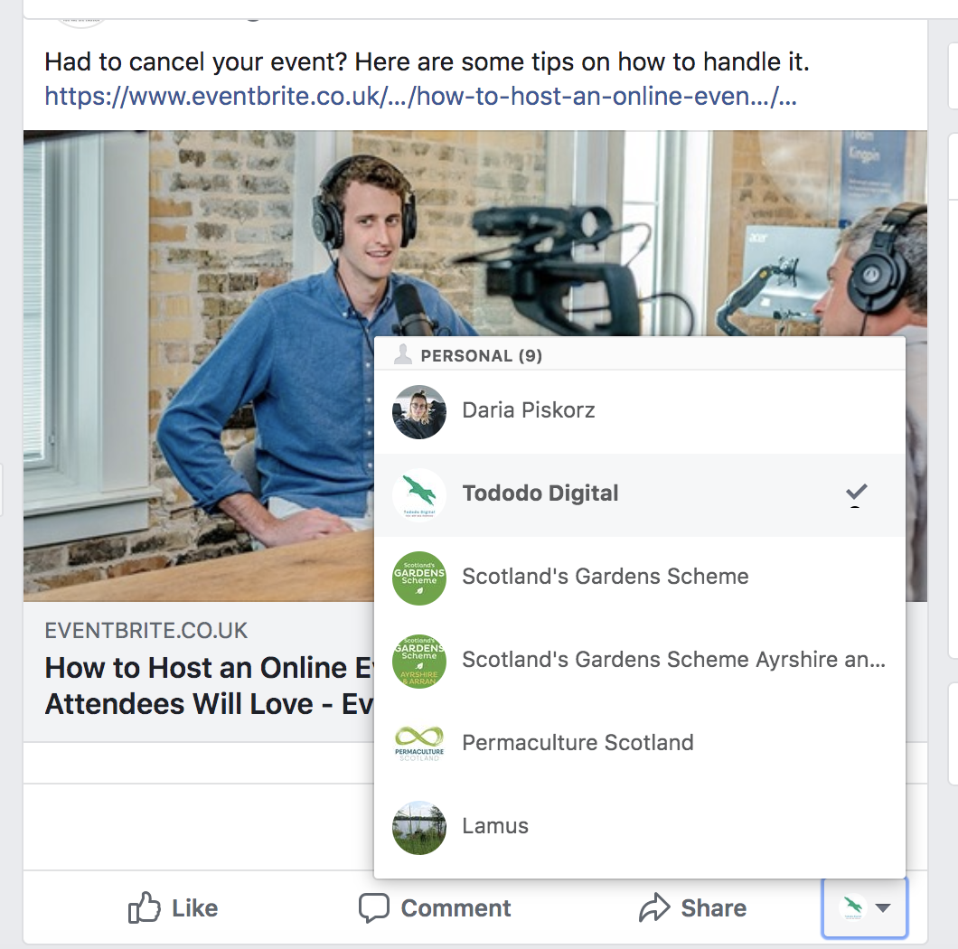
CREATE A POST – COMMENT AND SHARE
Your post has been published. Now onto commenting and sharing.
The tick tells me who I am liking, sharing and commenting as. If I clicked on Daria Piskorz, it will be changed from my business, to my personal account.
If you want to ‘like’ your own post, make sure you do it as you, not the Business Page. You can change who you are when liking and commenting by clicking here.

Slide 21
CREATE A POST – ADD AN IMAGE OR VIDEO
A window will pop up with folders on your computer, where you can choose the file you want to upload.
It is a good idea to have a folder with a selection of pics ready, so you always know where to look for your images.
Click on Photo/Video

Slide 22
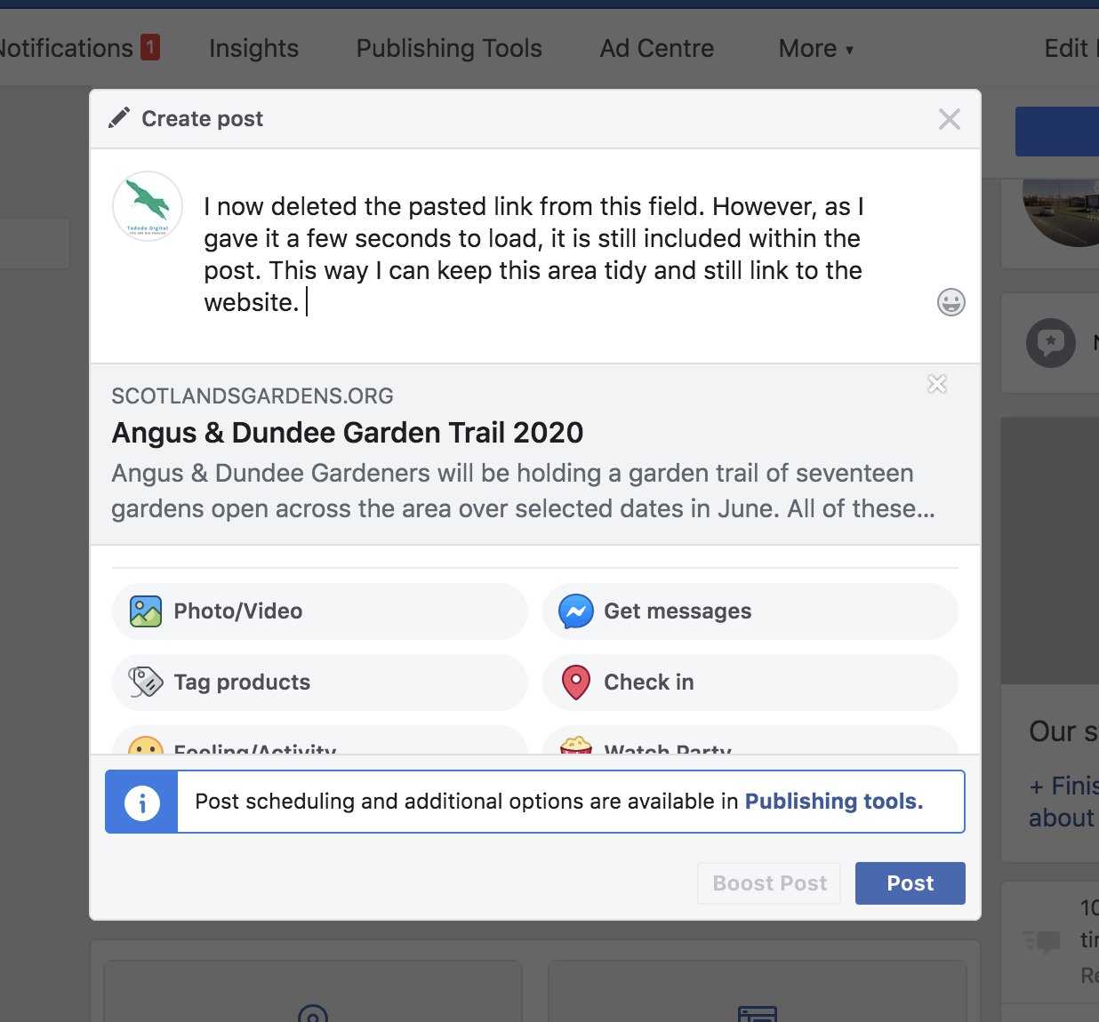
CREATE A POST – LINK TO A WEBSITE
After few seconds, when the link loads here, you can remove the link from text box and write something else. The link will still be included.
Copy and paste a link to a page

Slide 23
CREATE A POST – LINK TO A WEBSITE
Often, when you paste a link, Fb fetches picture from the website you are linking to.

Slide 24
SCHEDULING POSTS
Go to Publishing Tools tab located in your top navigation bar

Slide 25
SCHEDULING POSTS – PUBLISHING TOOLS
Click on ‘Create’ to create a post
You can see all your published, scheduled or in draft posts here

Slide 26
SCHEDULING POSTS – PUBLISHING TOOLS
When you are done creating, you can publish, schedule or save as a draft and finish later.
These options can be found here.

Slide 27
COVER PHOTO - CHANGE
Click on ‘change cover’ in top left corner of cover photo to reveal options.
You can choose from existing photo library of your page, or upload from your computer.
The dimensions for a Facebook cover photo are 828 x 315 pixels. It’s also important to remember that the mobile-friendly area falls within 560 x 315 pixels.
Don’t let this specs discourage you though – any landscape picture will do. Just bear in mind it will get cropped by Fb.

Slide 28
COVER PHOTO – DESCRIPTION FIELD
Now click on your newly added cover pic and fill out description field. Never miss the opportunity to add a bit of info.
Here we mention one of the gardens and link to their page on SGS website.
Make sure to CREDIT PHOTOGRAPHER. If their name appears on the website – they need to be mentioned.

Slide 29
PLANNING AHEAD
Our website allows you to filter by district and dates
List all the open days in your district – starting with specific date ones
Fill the gaps with ‘by arrangement’ gardens, call to action by saying ‘these garden openers are delighted to have visitors, give them a call to book your visit”.
Range of dates – a couple of weeks ahead of the first date, or when the garden is at its best
List special events, eg May Festival, Plant Sale, Village Opening, Garden Trail

Slide 30
PLANNING AHEAD
Sort open days by date and aim at promoting at least 7 days in advance.
You can group by garden features and create a photo carousel with eg gardens with water feature, including garden details under each photograph
Add to your calendar
Help your neighbouring districts by cross-promoting
Request an access to Marketing Plan created by HO

Slide 31
HOW TO FIND CONTENT
Simply select gardens in your area by date and promote at least a week before
Try to attend an open day, speak with the owners, take some photos or ask photographer to go with you
Find out more about plants, how the Garden Openers got interested in gardening, how did they start, what is most important to them, can they share any tips?
Can your fellow volunteers share some interesting stories, or pics or tips?
Share content from our core beneficiaries as well as other charity organisations that we support.
Share useful content from gardening websites, especially tips, sowing calendars, new trends. RHS website is great, also magazines
Occasionally share from pain SGS Fb page, always share important updates that impact all or most districts

Slide 32
INCREASE YOUR REACH
Tag our charities on relevant posts
Any special posts – ask me to share on main page
Create Facebook events for some or all open days (will show in people’s feed as events near you)
Sharing posts of other organisations with your comment (“Congratulations to QNIS for running another successful conference. We are proud to support your mission”)
Commenting on posts of other related organisations (“This shrub looks lush (responding to their content), I’ve seen the same plant at Glenwhan Garden last year, and it was just stunning (sharing your experience). I wonder if it would grow in North-West Scotland (question that others might like to answer – leaving the conversation open)”)
Create a poll
Like and follow gardens in your area who use Facebook as well so they can easily share their posts in times when it is quiet. Some private gardens will have pages, but all the NTS ones do and the Botanic gardens too.

Slide 33
CREATING FACEBOOK EVENTS
For specific dates events or a range of dates
Not so much for gardens open by arrangement, as the maximum event duration is
Recurring dates can only be added up to 52 times
For Open Days, Plant Sales, special events e.g. Storytelling Sessions

Slide 34
FACEBOOK EVENTS - INITIATE
Click on Events tab
Click on ‘Create Event’

Slide 35
FACEBOOK EVENTS – MAIN INFO
You can change cover photo here. Choose a landscape photo of the garden. If you want to be super tidy, the dimensions are 1200 x 628 (same as a link share). This is a 1.91:1 ratio
In a pop-up window, make your way down filling out details
Event name: make it short & relevant eg Garden Open Day, Braco Castle. There is 64-character limit.
Include as much detail as possible in Description box. What is your event about, also copy and paste a description of the garden from the website. Who it is for, what ppl can see/experience. Include information about admission – how much and where tickets can be purchased.
Location – if the garden is public, you should be able to find location by typing the name. If the garden is private, put the postcode or nearest town. You will also include directions in the description field.

Slide 36
FACEBOOK EVENTS – CATEGORY AND DATE
Category: choose the best for the type of the event. This could be ‘Gardening’ for most of our open days.
Choosing ‘Other’ as your event category will reduce the chances that your event will be found organically or within a search.
Choose whether the event occurs once or over a course of days. Add times. Keep in mind that events are limited to recurring 52 times, and location and timezone can't be edited once an event has started. All events hosted by Pages are public.

Slide 37
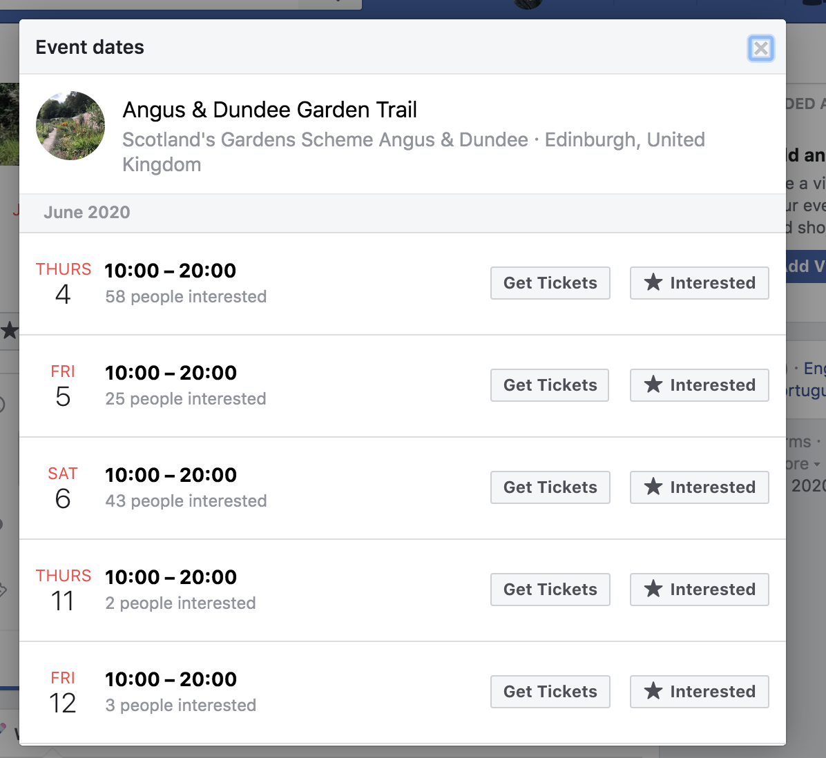
FACEBOOK EVENTS – MULTIPLE DATES
Angus and Dundee Garden Trail is running over certain days throughout June

Slide 38
FACEBOOK EVENTS – EVENT HOSTS
Invite co-hosts: Type in the name of the co-hosting organization and choose from the dropdown.
Always invite Scotland’s Gardens Scheme and where possible, the garden (make sure you add their official page as they will get edit privileges). This way you will let them share among their contacts and their followers can save the date.
Co-host needs to accept your invitation to host the event, so you can message them via Messenger if they haven’t accepted after a few days and remind them.

Slide 39
FACEBOOK EVENTS – SCHEDULE AND TAGS
If there is a certain schedule, you can add it here. For most our open days there is none.
Keywords: type in and select from the list. If your search is not coming up, you won’t be able to add it. Sadly, not many garden-related keywords yet.
Is your event child-friendly? Check the garden green icons for children activities.
There is certainly a volunteer opportunity

Slide 40
FACEBOOK EVENTS – TICKETS
Add ticket URL only if we sell through Eventbrite. For most open days tickets will be sold at the gate, and it should be stated in the description.

Slide 41
FACEBOOK EVENTS – POSTING, GUEST LIST
Allow anyone to post so you can engage with potential visitors. No need to approve but monitor the page frequently.
Leave unticked
Don’t display guest list

Slide 42
FACEBOOK EVENTS - PUBLISHING
Save draft if you want to come back to finish it later
Publish immediately.
Schedule – you can select a date when you want your event to be published. Make sure to get it published as soon as you have the basic details, and you can always add more info if needed.

Slide 43
FACEBOOK EVENTS – MAINTANANCE
Share the event on your page to increase visibility
Update the event with content like: Reminders, Behind-the-scenes info on preparation, where to park, photographs to increase engagement
As people engage with content on your event’s page, this may also show up in newsfeeds of their friends, increasing the visibility of your event even further.
Allow people to post on the event page and answer any questions. If you don’t know the answer – ask District Organiser, Head Office or, if necessary – the Garden Opener directly.
If you get the same question more than once, update your description to include that information.
Share live videos and photos from the event and thank everyone for coming

Slide 44
YOU COMPLETED PART 1
Now take your time to practise your skills. When you are ready - move on to Part 2 to learn more.
Happy posting!

