Slide 1
Scotland’s GARDENS Scheme www.scotlandsgardens.org

Slide 2
What we do
We help individuals and organisations to open gardens to the public.
We work with garden owners and volunteers to plan, promote and celebrate garden openings
We raise funds for charity through garden gate tickets, plant sales and refreshments.
We make sure funds raised go to those charities supported.

Slide 3
Our volunteers!

Slide 4
Introduction
Created in 1931 (celebrating 90 years!)
Fundraising Committee of the Queen’s Nursing Institute Scotland - District Nurses
The National Gardens Scheme 1926
Notes:
Founded with a really clear and simple purpose – to raise funds for the Queen’s Nursing Institute of Scotland,

Slide 5
Instant Success
1932 – the first full year
King opens Balmoral to the public
500 gardens opened
Notes:
Maybe because such a clear and simple idea peer pressure to open gardens large, grand, private gardens

Slide 6
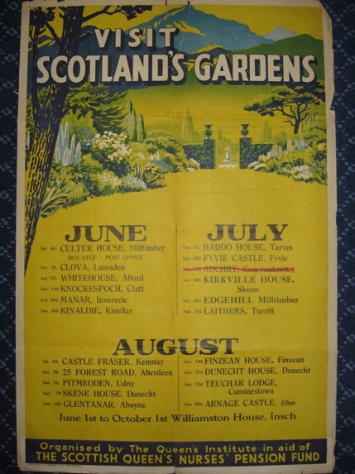
Notes:
Poster from the 1930s we think, thanks to the QNIS archive
Large gardens on the old estates opening for us; quite a few still open today.

Slide 7
Supporting the Nurses
Raising funds for the nurses
District Nurses’ annual pension of £20 doubled
Nurse training supported

Slide 8
War Years
Gardens continues to open although veg took over much of the flower beds
Special petrol allowance given to garden owners and bus operators
Tea continued to be served patriotically, and without sugar
Gardens opening dropped to about 300
Local openers can support their local nurses with 40% of funds raised

Slide 9
Post War
Creation of the NHS (1948)
Nurses get NHS support
1952 The Gardens Fund of The National Trust for Scotland
Gardeners’ Royal Benevolent Society

Slide 10
The 1960s
Charity distribution changes
40% of the funds raise at each garden opening goes to charity of GO choice
60% of the funds (net)
The Gardeners’ Royal Benevolent Society (Perennial)
The Royal Fund for Gardeners’ Children

Slide 11
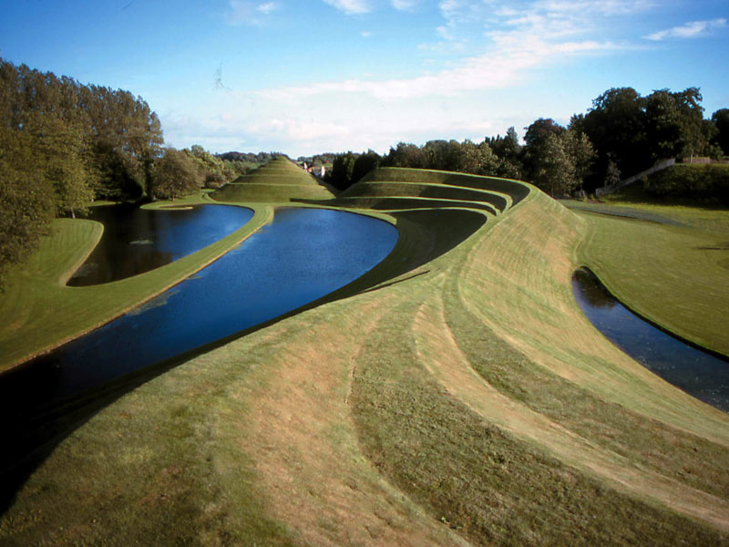
2007
Maggie’s Cancer Caring Centres

Slide 12
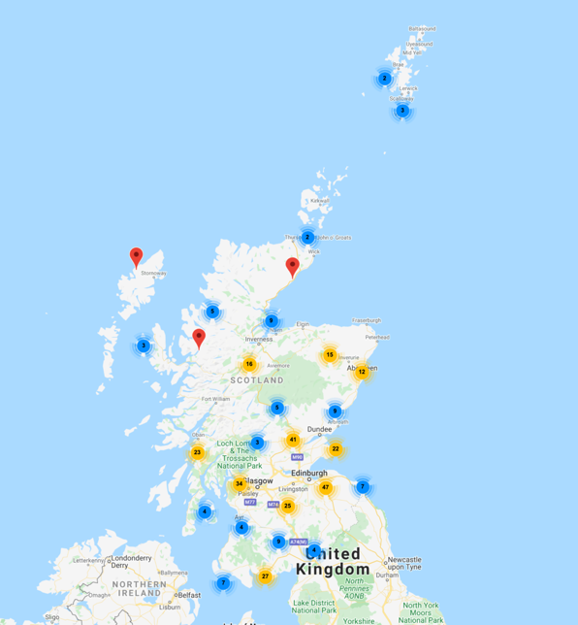
The Gardens
Across Scotland
All shapes and sizes
Villages, allotments, community gardens, stately homes, walled gardens, and many more…
Estimated 44,000 visitors

Slide 13
Stately Homes

Slide 14
Glen House, Peebleshire, by Kathy Henry
Notes:
Glen House, near Innerleithen in the Scottish Borders
Surrounding the outstanding Scots Baronial mansion designed by David Bryce in the mid-19th century, Glen House gardens are laid out on shallow terraces overhanging the glen itself, which offers one of the loveliest designed landscapes in the Borders. The garden expands from the formal courtyard through a yew colonnade, and contains a fine range of trees, long herbaceous border and a pool garden with pergola, all arranged within the curve of slopes sheltering the house.

Slide 15
Gardyne Castle, Angus
Notes:
Gardyne Castle, dating from the 16th century, with its a long romantic double border, bursting with tulips and alliums in May. And there’s a large enclosed knot garden of box and yew mixed with white roses and lavender. Beyond is an immaculate formal lawn surrounded by yew topiaries and specimen trees, leading to a wildflower meadow with a gentle path leading down through an orchard. To the north, a new upper garden, centred on an extraordinary pepper pot doocot, provides an area for quiet contemplation with white planting, a fishpond and the family’s collection of chickens. Beyond the formal gardens the grounds merge into mature woods and parkland with a spectacular display of bluebells and romantic walks along the Denton Burn.

Slide 16
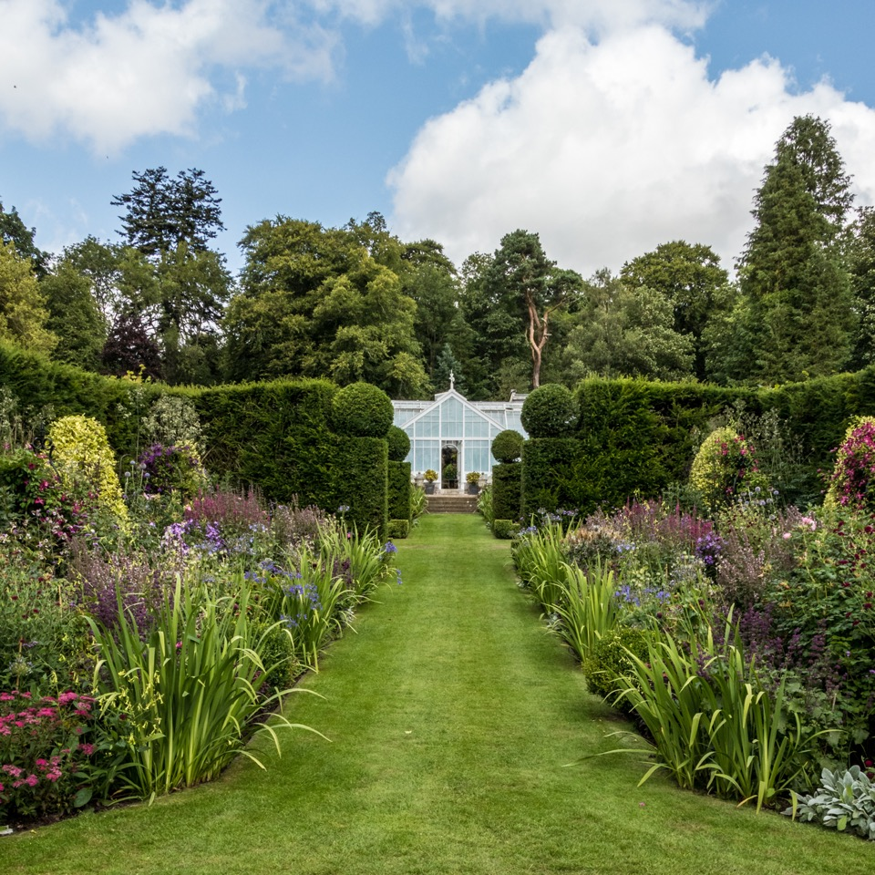
Portmore, Scottish Borders © Kathy Henry
Notes:
Lovingly created by the current owners over the past 30 years; the gardens surrounding the David Bryce-designed mansion house contain mature trees and offer fine views of the surrounding countryside. Large walled garden with box-edged herbaceous borders is planted in stunning colour harmonies, potager, rose garden, pleached lime walk and ornamental fruit cages. The Victorian glasshouses contain fruit trees, roses, geraniums, pelargoniums and a wide variety of tender plants. There is also an Italianate grotto and water garden with shrubs and meconopsis. The woodland walks are lined with rhododendrons, azaleas and shrub roses. Starred in Good Gardens Guide and featured in Kenneth Cox’s book Scotland for Gardeners and on The Beechgrove Garden.

Slide 17
Creative Places

Slide 18
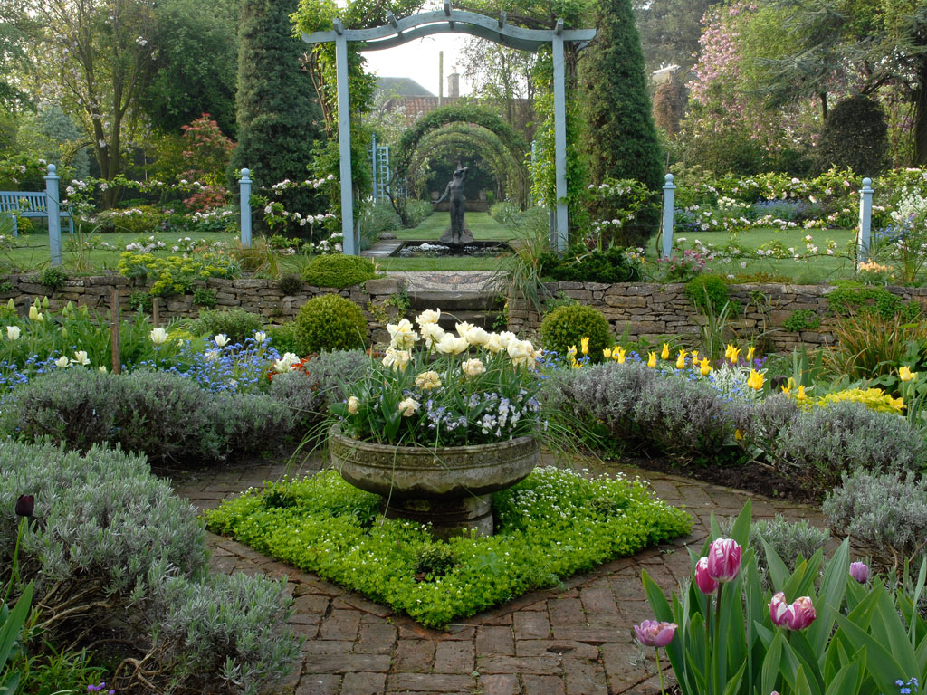
Shepherd House, East Lothian
Notes:
A constantly evolving artist’s garden that never stands still, with lots of surprises including a shell house built in 2014, lavender parterres, a rill and fountains. At its heart are the plants filling every border, spilling over arches and lining paths, which are the inspiration for Ann’s paintings. The season starts with the snowdrop collection of over 70 cultivars, moves on through hellebores, tulips, irises and roses. One of the garden's features is a mirror steel diamond sculpture to commemorate the Frasers' diamond wedding anniversary and 60 years in this garden.

Slide 19
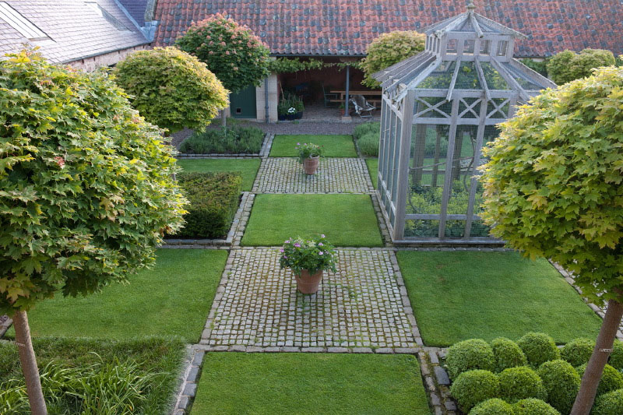
Broadwoodside, East Lothian
By Andrea Jones
Notes:
Broadwoodside, full of creative twists and artworks, with beautiful planting that changes through the year to create a series of different moods.

Slide 20
Jupiter Artland, Edinburgh, by Allan Pollok-Morris
Notes:
Bonnington House garden, opening for the first time in 2021 and a rare chance to see the other side to Jupiter Artland. Opened in support of Motor Neurone Disease.

Slide 21
Walled Gardens

Slide 22
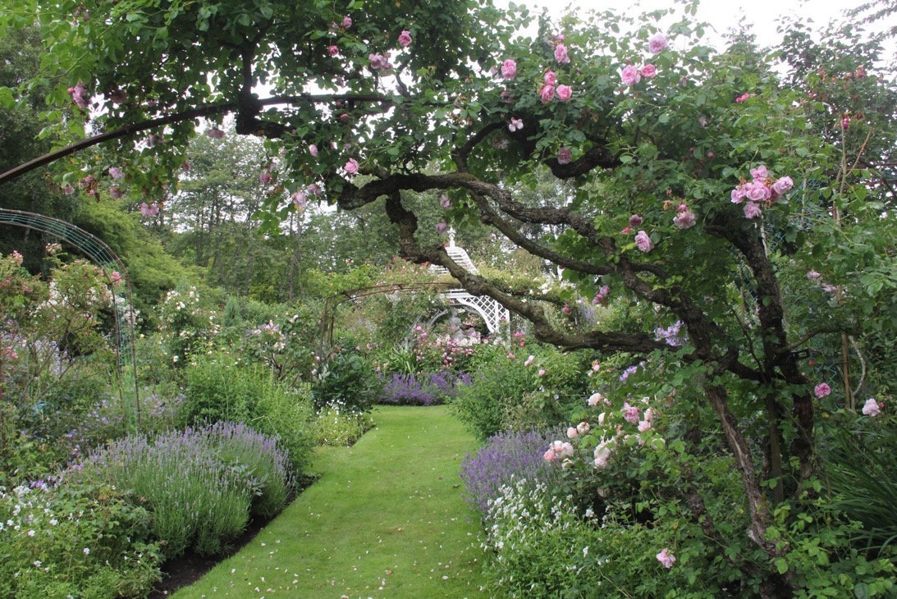
The Walled Garden Tyninghame, East Lothian
Notes:
Tyninghame has opened for over 80 years and has a notable walled garden; not just herbaceous plantings but also specimen trees, interesting to see in the walled garden setting.

Slide 23
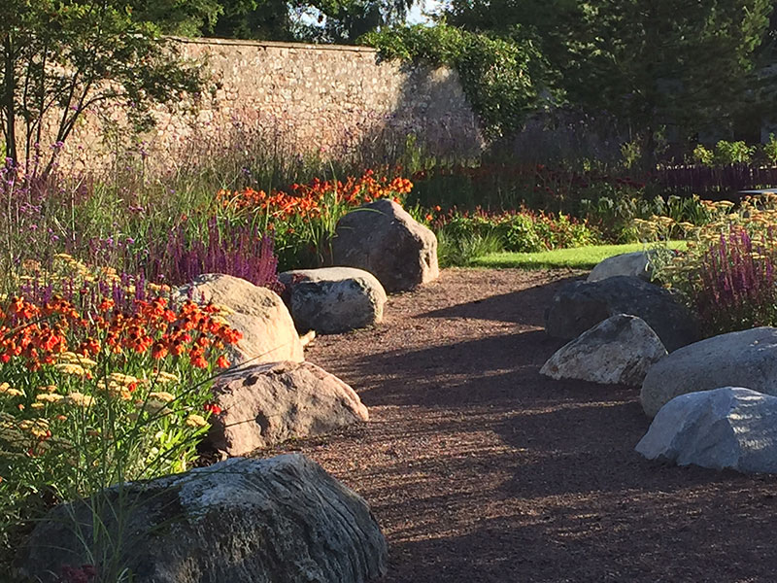
The Walled Garden Shieldhill, Quothquan
Notes:
This 200-year-old walled garden was completely redesigned and planted in 2014/15 with contemporary features within a classic design. The garden incorporates a modern rill and banks of colour with perennial flowers in a variety of borders. The resident bees enjoy the large area of traditional meadow flowers as well as the rose garden planted with lavenders, salvias and stocks. Outside the wall you will find mature woodland including a giant sequoia and a wildlife pond. If you are interested in fruit and vegetables, take a look at the raised beds and the peach tree and vine in the greenhouse. There are many secluded spots around the garden to sit and enjoy a cup of tea and a home-made cake.

Slide 24
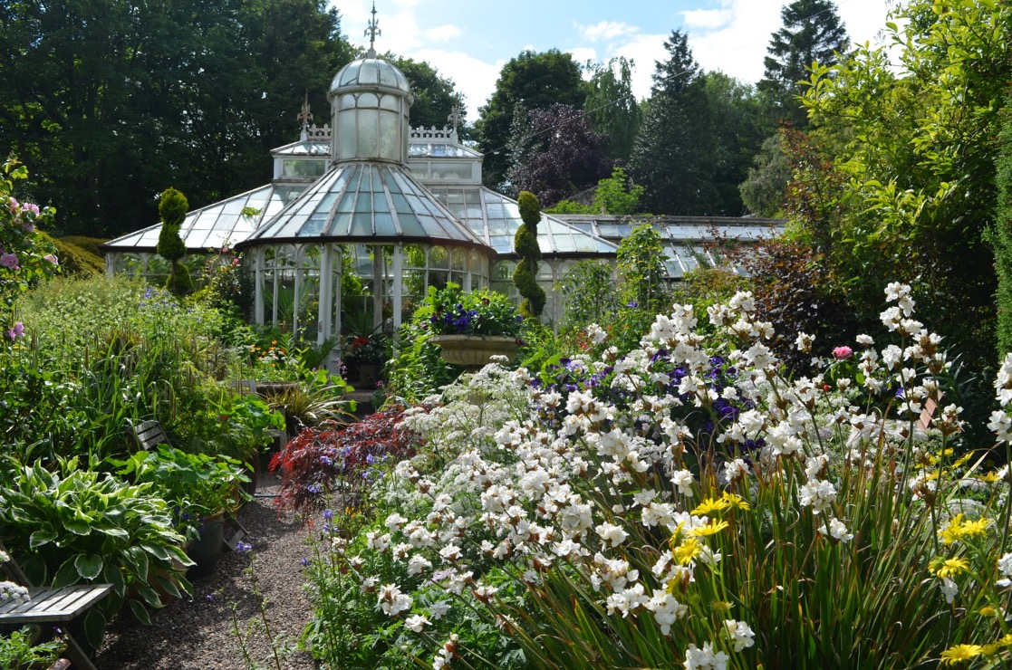
Glassmount, Fife
Irene McLaren
Notes:
Mackenzie & Moncur glasshouse – example of the kind of hidden gems to be found in our gardens.

Slide 25
Plants People & National Collections

Slide 26
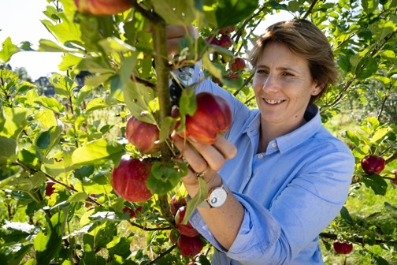
Catherine Drummond-Herdman, Megginch Castle, holder of the National Scottish Heritage Apple and Pear and National Scottish Cider Apple collections. The tree is a ‘Bloody Ploughman’
Notes:
The story is that a gamekeeper shot dead a ploughman caught stealing apples from the Megginch Estate. When his body was returned to his wife, she found stolen apples in his pockets and threw them onto a rubbish heap. One of the resulting seedlings bore apples of a deep, blood red. This tree gave rise to the cultivar that was named after the unfortunate ploughman. The apples have a crisp and juicy flesh with a deep blood red skin and bumpy texture. A truly mysterious apple with flavour to match.

Slide 27
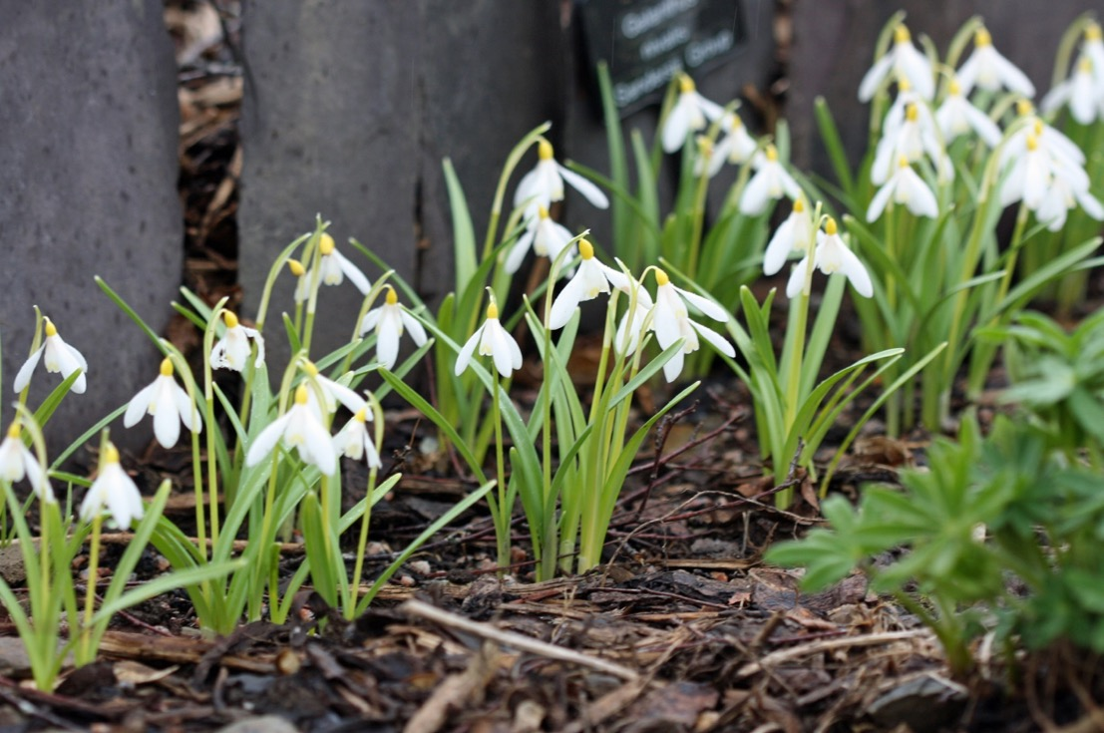
Bruckhills Croft, Aberdeenshire
Notes:
An informal country-cottage garden extending to three-quarters of an acre with a further acre as wildflower meadow and pond. There are several distinct areas which include a white border, a butterfly alley, kitchen garden with polytunnel, greenhouse and fruit cage, an orchard and a blue and yellow border. Relax on one of the many seats in the garden and soak up the atmosphere.
National Plant Collection: Galanthus, awarded in 2021.

Slide 28
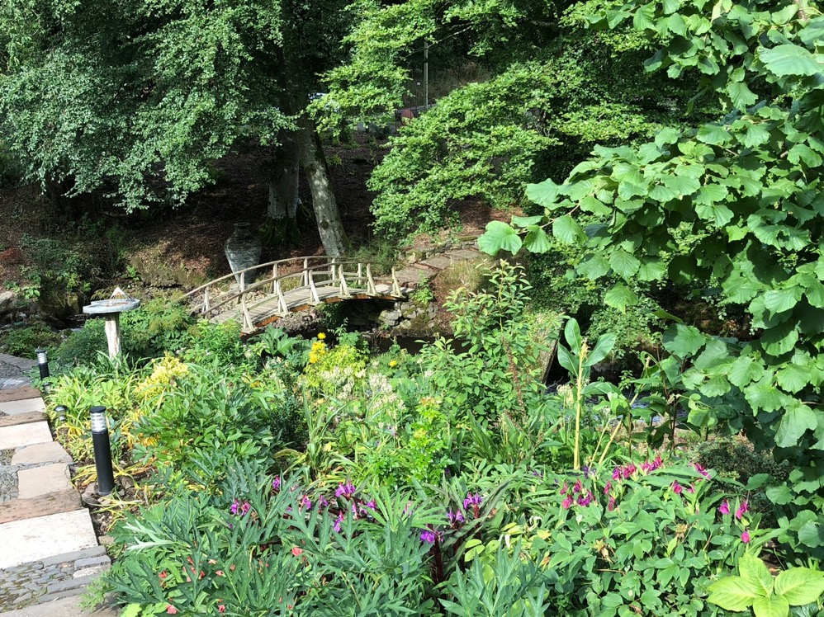
Dalswinton Mill, Dumfriesshire
Notes:
A developing garden with the owner’s growing collection of Roscoea; owners by the former Curator at RHS Wisley and Head Gardener to the Queen Mother – a true plantsperson.

Slide 29
Views & Far-flung Places

Slide 30
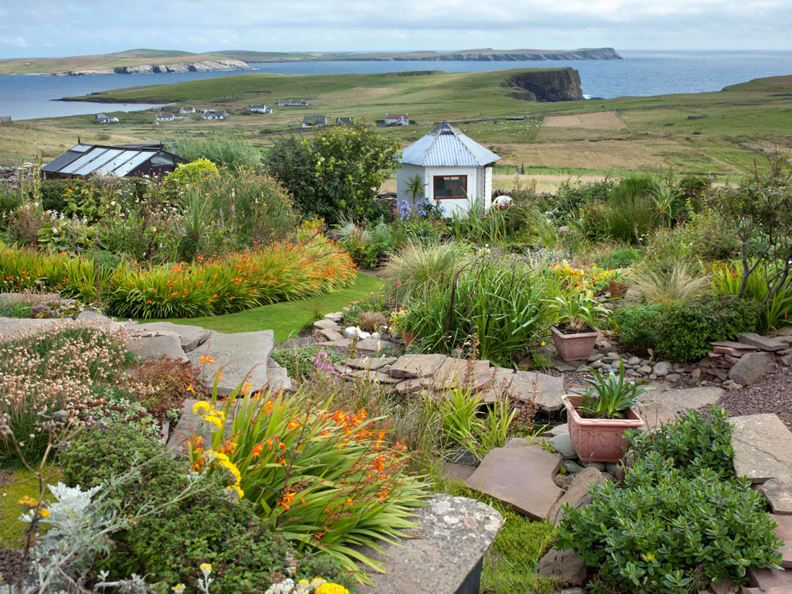
Nonavaar, Shetland © Andrea Jones
Notes:
Gardening on the edge, with low planting hugging the ground

Slide 31
2 Durnamuck, Little Loch Broom
Notes:
The garden is south-east facing on the edge of Little Loch Broom. It is a coastal plantsman’s garden with a rich mix of herbaceous borders, trees and shrubs, vegetables, drystone wall planting, South African/Mediterranean plants, a wild meadow and stunning views. Many of the plants have been collected from all over the world, and growing them has provided obvious challenges but with a pleasing outcome. Featured in 2019 entries in Gardens Illustrated, Homes & Gardens, and the Beechgrove Garden. Entry in the English Garden magazine in September 2020. A wood and stone Wee Garden Hut accommodation soon to be available for garden passionate people. Small and compact but very beautiful in its own garden.

Slide 32
Langwell,
Caithness

Slide 33
Curated Collections

Slide 34
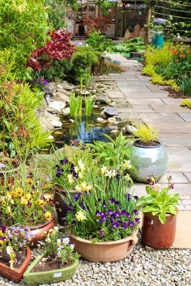
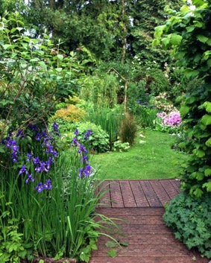
Dundee & Angus Trail
A special collection of 15 gardens open Thursdays/Fridays and Saturdays in June
£20 ticket giving flexible access to gardens
Notes:
Many of these gardens are new to SGS and run from Dundee city centre to the coast around Arbroath, through Forfar to Edzell and down to Meigle. Visit a community garden, a productive walled garden, as well as 12 other private gardens of varying sizes and styles. Fantastic value

Slide 35
North Lodge, Edzell, Angus & Dundee Trail

Slide 36
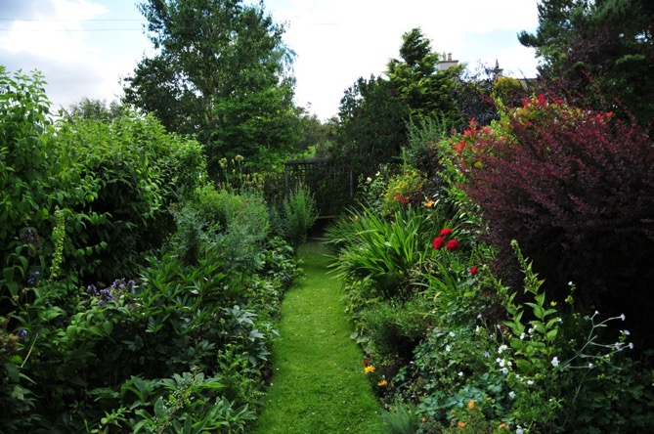
Groups & Villages
39 groups and villages opening through June to August
Marlfield Gardens, Berwickshire

Slide 37
Gardens of the Highest Villages

Slide 38
Get Involved
Open your garden – or encourage someone else!
Visit a garden (or two or three…)
Help on an Open Day
Join a local group of volunteers
Love gardens?
Marketing skills?
Social media skills?
Enjoy working as part of a team?
Love baking?

Slide 39
Selecting Gardens
Willingness to open
‘Loved’ gardens
Good standard
Horticultural interest
45 minutes of interest – alone or grouped with other gardens

Slide 40
Kinds of Openings
Single day(s) or weekend
Usually 2-5pm, extending to noon-6pm
Extended period – range of dates
By arrangement
Private openings
Pop-up
Plant sales
Teas!

Slide 41
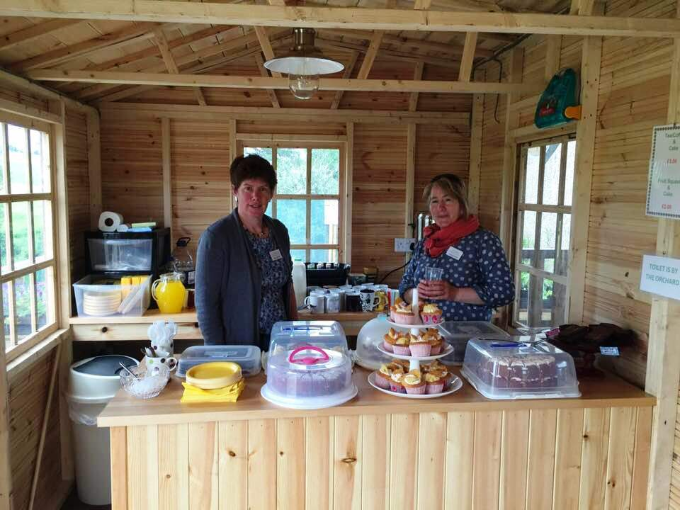
Teas!

Slide 42
Supporting Openers
Annual guidebook ‘yellow book’
Website listing
Local leaflets
Social media
Local posters
Road signs, banners, tickets, garden signs
Press releases, newspaper features
Morale support, recognition, celebration!

Slide 43
Insurance
Public Liability
All private domestic owners who are not otherwise covered
Product Liability
For the teas
Employer’s Liability
For the volunteers helping on the day

Slide 44
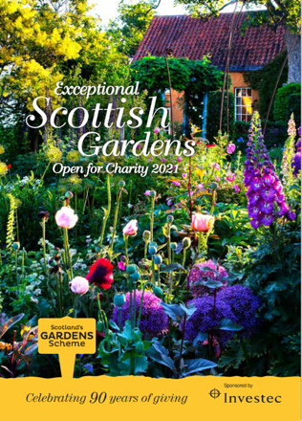
The ‘Yellow Book’
Published annually
Information on:
All the gardens
Our charity
The beneficiaries
£7.50
Available online
Sponsored by
Investec

Slide 45
Where the Money Goes
Over the past 5 years….
Over £1 Million to charity
Over 600 charities supported
Over 1,000 gardens opened
60% gross of funds raised to nominated charity
250+ charities supported each year
40% net of the funds raised:
Maggie’s Cancer Care Centres
The Queen’s Nursing Institute Scotland
Perennial

Slide 46
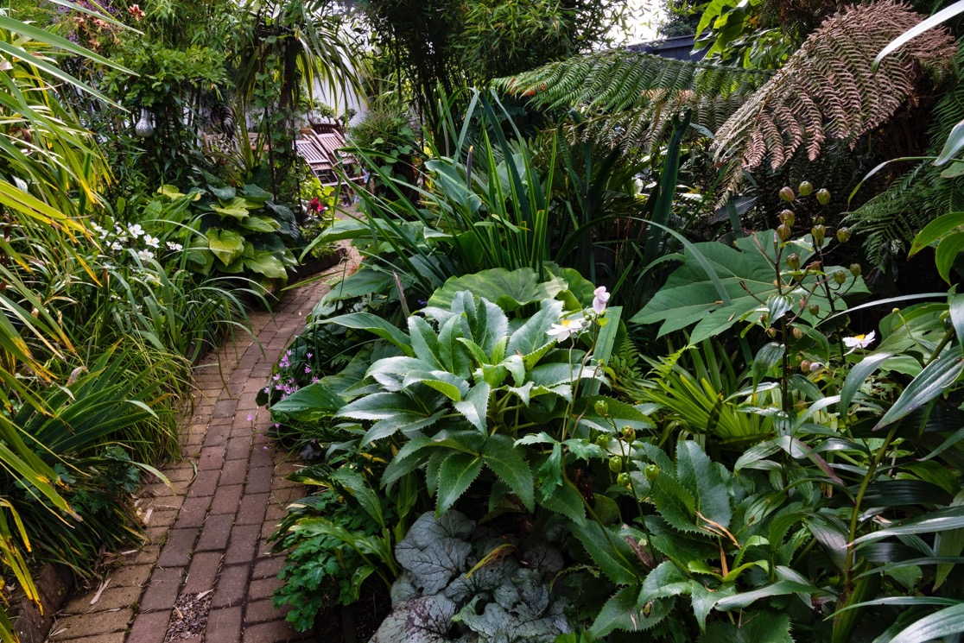
New Gardens
1 Burnton Rd, Dalrymple © David Blatchford
Notes:
Small and perfectly formed, exotic garden

Slide 47
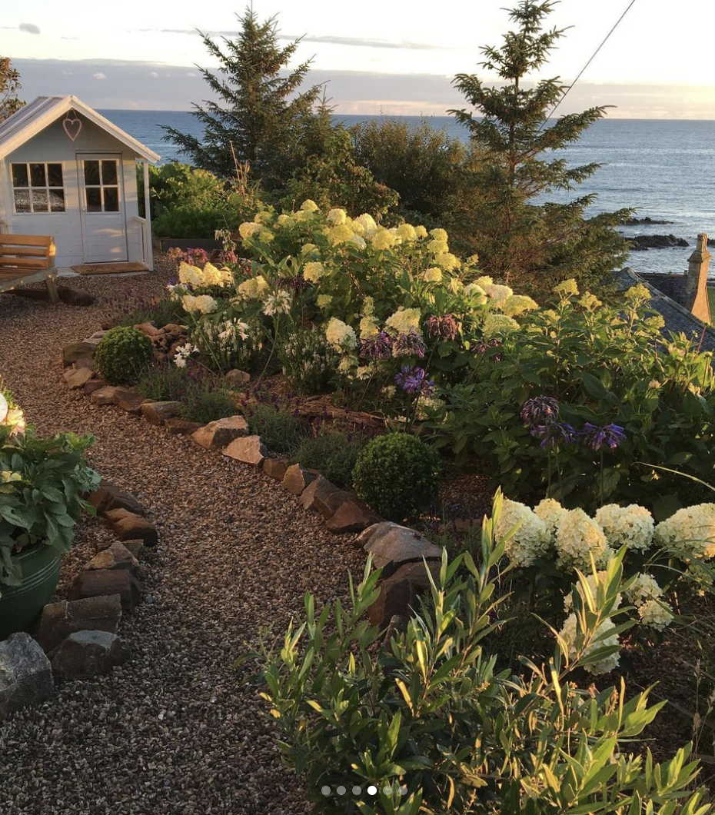
Cuthberts Brae, Buckie
Notes:
New gardens, created with love

Slide 48
Chris and Jerry, at home at Greenbank Crescent
Notes:
We couldn’t do it without our volunteers who make it all happen

Slide 49
Thank you!
0131 226 3714
info@scotlandsgardens.org
scotlandsgardens.org

